Slide 1
CONTINUING PROFESSIONAL DEVELOPMENT (CPD) REGULATION FOR RCICs
Hjalmar Leon, RCIC

Slide 2
Basic definitions
Activity means an educational seminar, workshop, or conference. An Activity is a distinct Approved CPD Activity meant to develop the skills, knowledge, and Competence of a Licensee;
Approved CPD Activities means professional development Activities approved by the Council*;
Approved Subject Matter means subject matter that meets the requirements of section 5 of the CPD Regulation;
Competence means the knowledge, skills and judgment required to successfully perform work functions and tasks in a defined work setting;
Provider means a registered business, not-for-profit Organization, government agency, provincially accredited educational institution, or an Organization officially recognized by another Regulatory Body for continuing professional development;
(*) now, the College of Immigration and Citizenship Consultants

Slide 3
Basic definitions
Term means a one (1) year period to complete CPD requirements pursuant to section 4 of the CPD Regulation;
Latest Continuing Professional Development Regulations, posted version: 2021-003, approved by the Board of Directors: November 17, 2021

Slide 4
Scope and Exemptions to Meet CPD Requirements
Every Licensee, in every Class of Licence, shall carry out their continuing professional development (CPD) activities in the form and manner approved by the Council(*), and consistent with the Essential Competencies for RCICs;
Licensees on Leave: Licensees on approved leave by the Registrar are still required to earn CPD hours for the duration of their leave as per section 4 of the Regulation. Although, Licensees will receive one (1) CPD hour reduction for each month on leave;
(*) now, College of Immigration and Citizenship Consultants

Slide 5
Scope and Exemptions to Meet CPD Requirements
Active Licensees are required to achieve the minimum CPD requirements (as of today 16 credit hours)set out in section 4 of the Regulation in order to remain in Good Standing.
In every Class of Licence, a licensee shall carry out their continuing professional development (CPD) Activities in the form and manner approved by the Council*, and consistent with the Essential Competencies for RCICs;
CPD Regulation applies to Licensees living or working inside or outside Canada

Slide 6
Scope and Exemptions to Meet CPD Requirements
It is the sole responsibility of each Licensee to ensure their CPD hours are properly reported annually via the prescribed process;
CPD reporting cycle: July 1 to June 30 of the following year (12 months);
You must complete the CPD Attestation Form and upload it when completing your Annual Renewal through the YM online portal;
June 30: Deadline to complete the Annual Renewal and submit the CPD Attestation Form. NOTE: CPD submissions made via email or postal mail will not be accepted by the College.
A Licensee is responsible for retaining records such as receipts or other proof of attendance or purchase of CPD Activities for a period of five (5) years.

Slide 7
Subject Matter Requirements for CPD Hours
The primary objective of CPD is to increase Licensees’ professional Competence. Approved CPD Activities must align with the Essential nine Competencies for RCICs outlined below and apply to Canadian immigration and citizenship consultancy, including:
(a) Foundational Knowledge;
(b) Case Management;
(c) Legal Research and Informatics;
(d) Business Management and Leadership;
(e) Immigration and Refugee Board (IRB) and Administrative Tribunals;
(f) Professionalism;
(g) Cultural Competence;
(h) Communication, Counselling and Advocacy;
(i) Critical thinking, Problem solving, and Evidence-Based Practice.

Slide 8
Activities Eligible for Licensee CPD Hours
Eligible Activities:
(a) Participating in approved CPD Courses or Programs, including:
• Attending in person or online, live CPD Courses or Programs that provide an opportunity to interact with colleagues and/or instructors;
• Reviewing a recorded CPD Course or Program and summarizing the learnings from the Approved CPD Activity;
• Participating in asynchronous, online CPD Courses that prompt responses throughout the learning process, such as requiring participants to respond to questions before they can move to the next module or section; and/or
• Participating in conference sessions, seminars, workshops, etc.;
(b) Participating in a post-secondary educational institution Course or Program;

Slide 9
Activities Eligible for Licensee CPD Hours
Eligible Activities:
(c) Teaching, including:
• At a post-secondary education Program accredited by the Council* (now the College);
• Facilitating a CPD Activity for an approved CPD Provider;
• Facilitating a session, workshop, or seminar at an approved conference; and/or
• Facilitating approved group case study discussions;
(d) Writing a book or article for publication, based on Approved Subject Matter, with or without a co-author, where the content aligns to the Essential Competencies for RCICs and Canadian immigration and citizenship consultancy;
(e) Acting as a mentor through the Council’s Mentoring Program;

Slide 10
Activities Eligible for CPD Hours
Eligible Activities:
(f) Participating in Activities related to the observation of proceedings before a tribunal or court with the exception of Licensees who are completing, or have completed, the Specialization Program where observing tribunal proceedings is a mandatory requirement; and
(g) Participating in group case study discussions which, to be approved, must meet the following parameters:
• More than one (1) RCIC must be present;
• Groups cannot exceed fifteen (15) participants; and
• File-specific discussions are not eligible

Slide 11
Activities NOT Eligible for Licensee CPD Hours
Not Eligible Activities:
(a) Practice Management Education (PME) Courses;
(b) Participating in the Council’s Mentoring Program as a mentee;
(d) Content that does not relate to the Essential Competencies for RCICs;
(e) Content and Activities designed for or targeted at soliciting Clients, relating to marketing or maximizing profit;
(f) Pro bono work;
(g) Activities relating to mentoring other Licensees that are not part of the Council’s Mentoring Program;
(h) Activities marketed as offering a specialized credential. Such Activities are subject to suspension or revocation of approval as outlined in section 12 of this Regulation; and
(i) Activities with the same content but delivered in different formats (for example, live online session vs. recorded session) cannot both be claimed towards annual CPD requirements.

Slide 12
Suspension or Revocation of approved CPD activities
The Council reserves the right to suspend or revoke the approval of CPD Activities when:
(a) The CPD content of a Provider’s Activity no longer meets the criteria and requirements of the CPD Regulation
(b) The information that the Provider conveys to Licensees is inaccurate, untrue, or misleading; or
(c) There are legitimate concerns or complaints about the delivery of a Provider’s Activity or the conduct of the Provider.

Slide 13
Verification of CPD Reporting
Licensees are randomly selected annually to be audited for compliance with the CPD Regulation.
A Licensee is responsible for retaining records such as receipts or other proof of attendance or purchase of CPD Activities for a period of five (5) years. Therefore, keep all CPD records or documents for 5 years that show you completed your CPD (for example, proof of payment, invoices, proof of registration, proof of attendance, certificate of completion).
Licensees randomly selected to be audited will be notified via email. The notice shall specify the information required from the Licensee and the format in which the information is to be submitted.
A Licensee shall comply with the notice pursuant to section 14.3 of the CPD Regulation within thirty (30) calendar days of the date of that notice, by providing all information as required. If you don’t comply, you may be fined or have your license suspended.
The information provided be the licensee will be reviewed pursuant to section 14.4 of the CPD Regulation. Licensees are required to provide additional information, if requested, within ten (10) calendar days of the request.

Slide 14
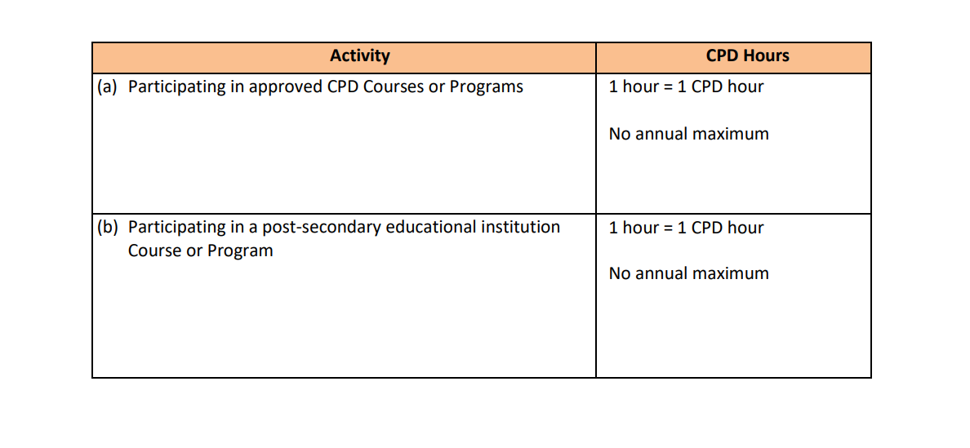
Calculation of CPD hours

Slide 15
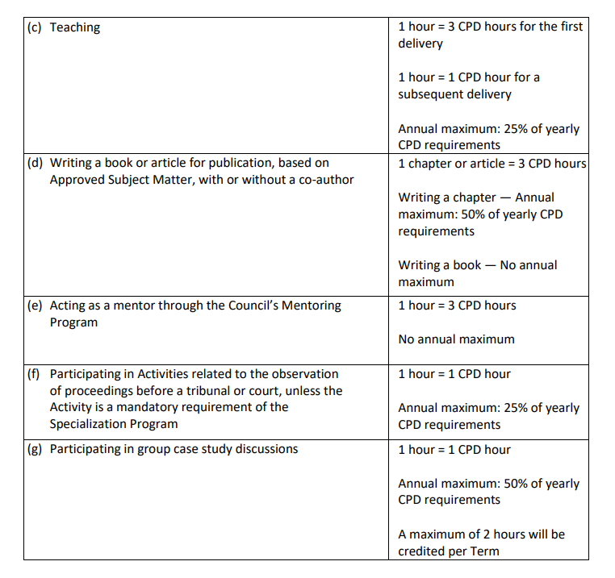
Calculation of CPD hours

Slide 16
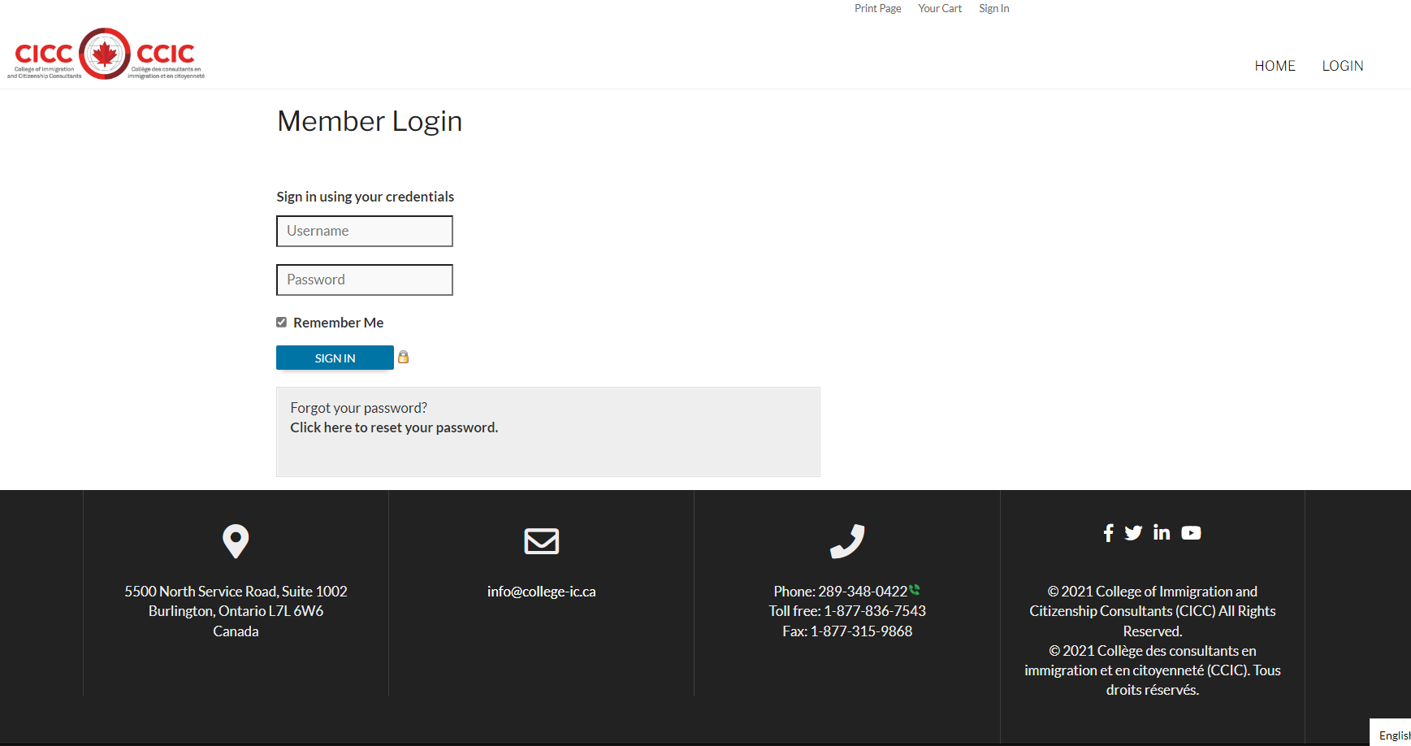
Current CPD Reporting Login Page https://iccrc-crcic.site-ym.com/login.aspx

Slide 17
Penalties for Breaching the CPD Regulation
A Licensee who does not meet the requirements for CPD as set out in sections 3 and 4 of the Regulation is subject to the following penalties:
(a) A $150 non-refundable fine for not completing the required CPD hours within the Term. The outstanding CPD balance from the previous term will be added to the following term’s requirement.
(b) Where a Licensee fails to complete any CPD hours for two (2) consecutive terms, the Licensee will be suspended by the Registrar. A minimum of 25% of the deficient CPD hours over the two (2) year Term must be completed and a plan to complete the remaining 75% of the deficient CPD hours must be submitted and approved by the Registrar prior to reinstatement.
CARRY-OVER OF CPD HOURS
A Licensee who has earned more than the mandatory sixteen (16) CPD hours required in a reporting Term is entitled to carry over a maximum of six (6) CPD hours to the next reporting Term. For CPD enquiries and questions: cpd@college-ic.ca

Slide 18
Thank you !
_______________________

